Slide 1
Tutorial-11: Deep learning for inverse problems and beyond.
Sanketh Vedula
sanketh@cs.technion.ac.il

Slide 2
Administrative stuff
Guidelines for presentations are posted on the course website.
We will publish the order of presentations, the talks would likely take an extra half or one hour i.e., 8:30AM-11:00AM (or 11:30AM) on 21st Jan.
If your talk is missing on the list, please email me.
If you have lessons between 10:30-11:30AM, please let me know, your talk will be pushed backward in time.
Please email your presentations to sanketh@cs.technion.ac.il by 20th Jan.

Slide 3
Agenda
Inverse problems: a supervised learning approach
Neural networks
Convolutional neural networks
Loss functions, backpropagation, optimization
Architectures: Encoder-decoder with symmetric skips, U-Net
Applications: Denoising, CT & MRI reconstruction, DeepISP
Perceptual losses
Feature reconstruction loss
Style reconstruction loss
Applications: super-resolution, style-transfer

Slide 4
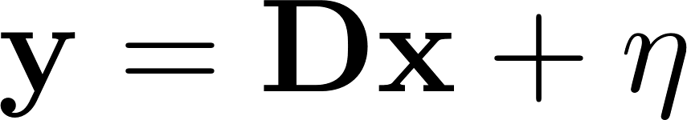
Inverse problems
Degradation operator
vector
Measurement
If D is:
Focal blur
Motion blur
Identity
Identity with missing values
Random gaussian matrix
Projection matrix
and so on…..
Then recovering x from y is:
Super-resolution
Deblurring
Denoising
Inpainting
Compressed sensing (x is sparse)
Tomography
and so on…..
Today: we want to solve this as a supervised learning problem!

Slide 5
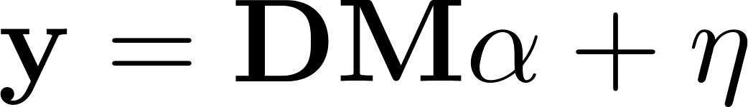
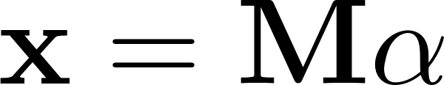
Previously in
We learned:
x is sparse with respect to a dictionary M. Use K-SVD to learn a dictionary M and recover x.
x is a patch. Find similar patches across the whole image and average them depending on the similarity. (Non-local means)
Similar patches in x are collected and sparsity is seeked w.r.to the collection in a transform domain (BM3D)
Today: we want to solve this as a supervised learning problem!

Slide 6
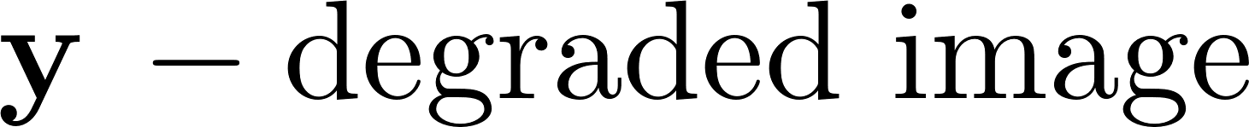

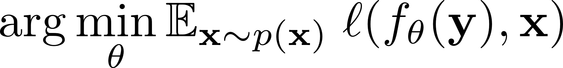
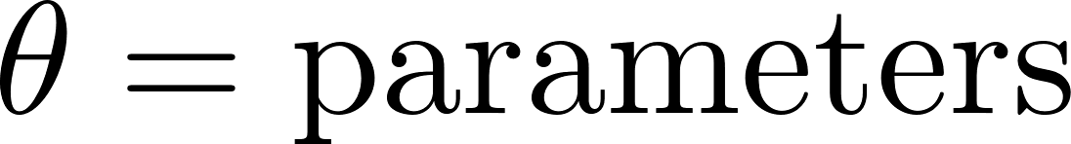
Inverse problems: supervised learning approach
Ideally, we would like to minimize the following risk:

Slide 7
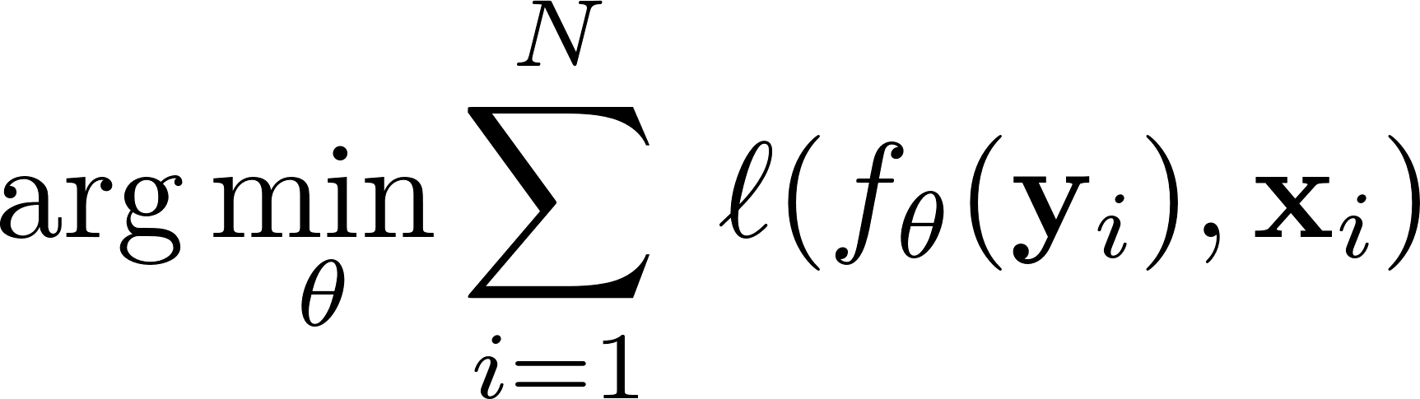
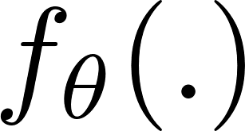
Inverse problems: supervised learning approach
Empirically, we would not have all the distribution of x, but we have access only to a few examples. Then, the loss function becomes:
We seek an with good approximation capabilities.

Slide 8
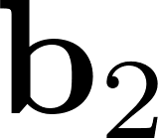
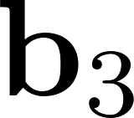
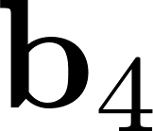
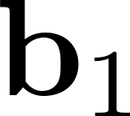
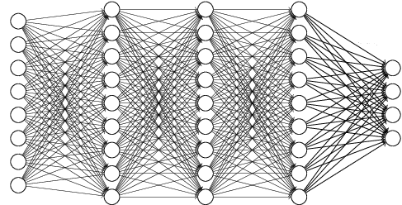
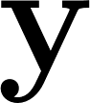

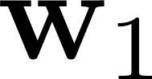
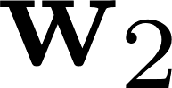
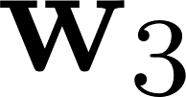
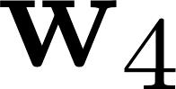
Neural networks

Slide 9

Activation functions
Image: © CS 231n, Stanford

Slide 10
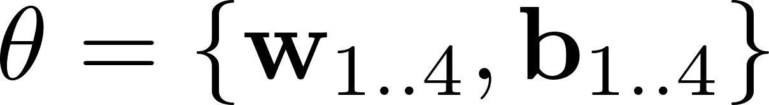
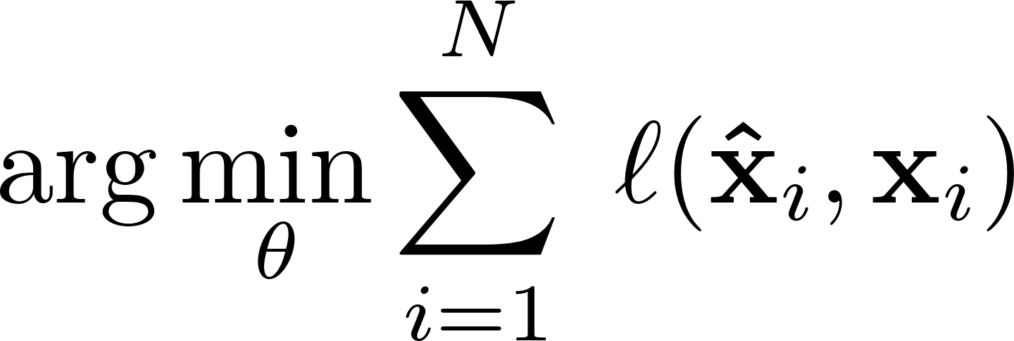

Loss functions

Slide 11
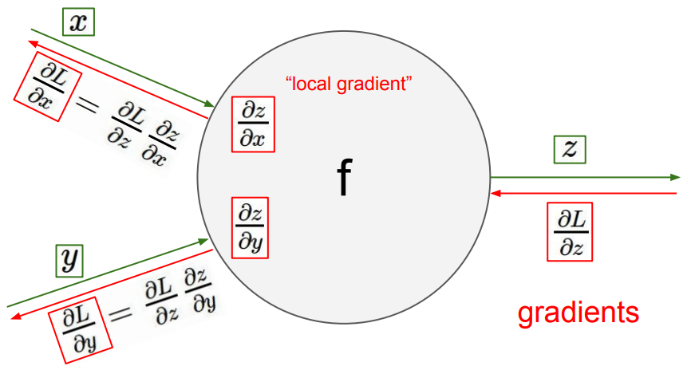
Backpropagation
Calculate the gradients of each w and b w.r.to the loss and update them accordingly.
The gradients of each layer are just calculated through backpropagation otherwise called “the chain rule”
Image: CS 231n, Stanford

Slide 12
Optimization: “stochastic” gradient descent
Gradient descent:
Calculate the gradient of the parameters w.r.to the whole dataset of samples.
Update the weights
Repeat 1-2 until convergence
Problem? Computationally very expensive to calculate the gradients w.r.to the whole dataset at once.
Stochastic gradient descent:
Sample a random “mini-batch” of data samples from the whole dataset
Calculate the gradient w.r.to the “mini-batch” of samples
Repeat 1, 2 until exhausting the dataset
Repeat the 1-3 until convergence
Stochasticity comes from picking random “mini-batches”

Slide 13
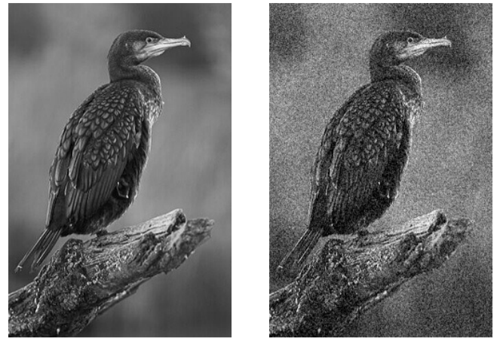
Image denoising using fully-connected networks
Dataset: Sample 362 million noisy and clean patch pairs from noisy and clean images.
Burger et al., Image denoising: Can plain neural networks compete with BM3D?, CVPR 2012

Slide 14
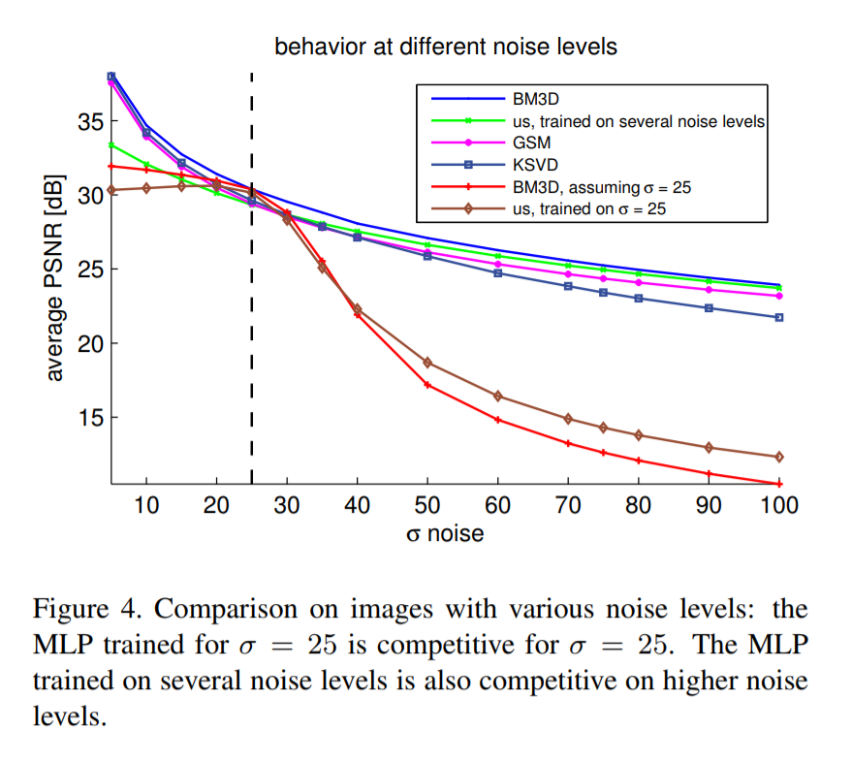
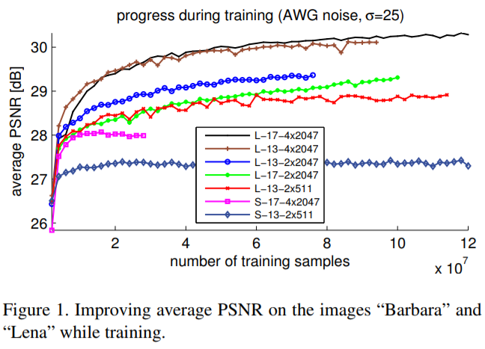
Image denoising using fully-connected networks
Effects of number and size of layers & size of dataset.
Comparison with BM3D, K-SVD
Burger et al., Image denoising: Can plain neural networks compete with BM3D?, CVPR 2012

Slide 15
Image denoising using fully-connected networks
What was missing??
Fully-connected networks just throw away the
spatial structure of images!
Sending in a patch like this is as good as just jumbling it and sending it in
Fix: Convolutional neural networks

Slide 16
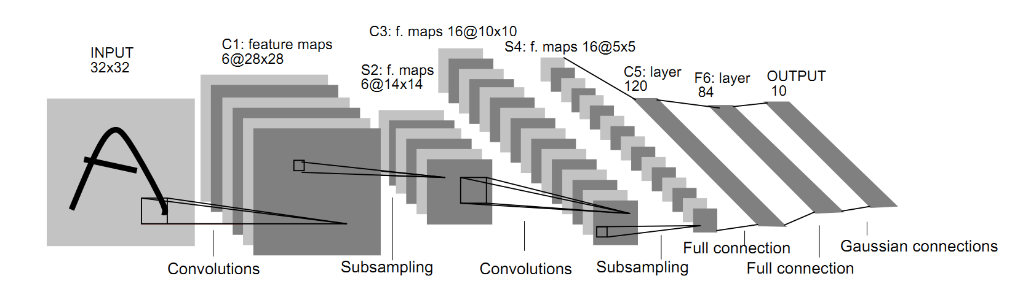
Convolutional neural networks
Convolutions capture local structure.
Hierarchies of features can be obtained by stacking convolution layers.
Image: LeCun

Slide 17

Convolutional neural networks
Deep learning jargon:
Conv = Convolution operation
ReLU = Activation function
Pool = Downsampling
Image: CS 231n, Stanford

Slide 18
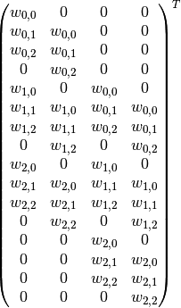

Convolutional neural networks
Each convolutional weight matrix is equivalent to fully-connected network with the block diagonal structure.
Hence, it is implemented as a sparse matrix multiplication and GPUs are very efficient in performing it.

Slide 19
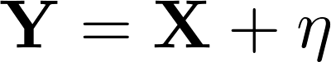
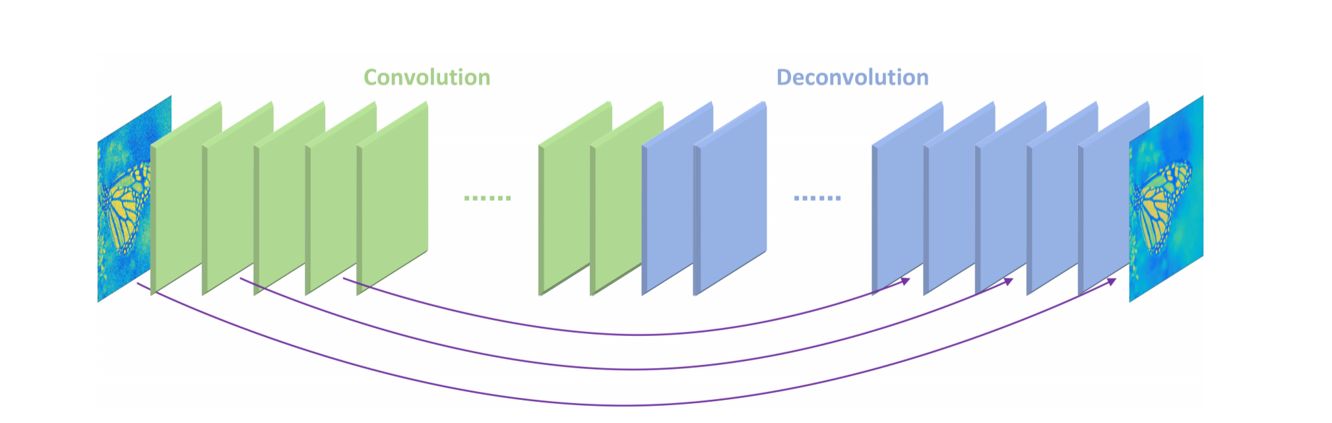
Encoder-decoder with symmetric skip connections
Image denoising:
Fully convolutional network:
transpose-convolution
Y
X
Key idea: Instead of learning to approximate X. Learn to approximate the residual (Y-X)
Symmetric skip connections prevent vanishing gradients and helps the convergence.
Mao et al., NIPS 2016

Slide 20
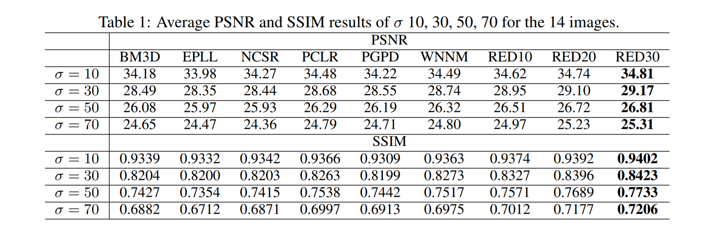
Image denoising
Mao et al., NIPS 2016

Slide 21
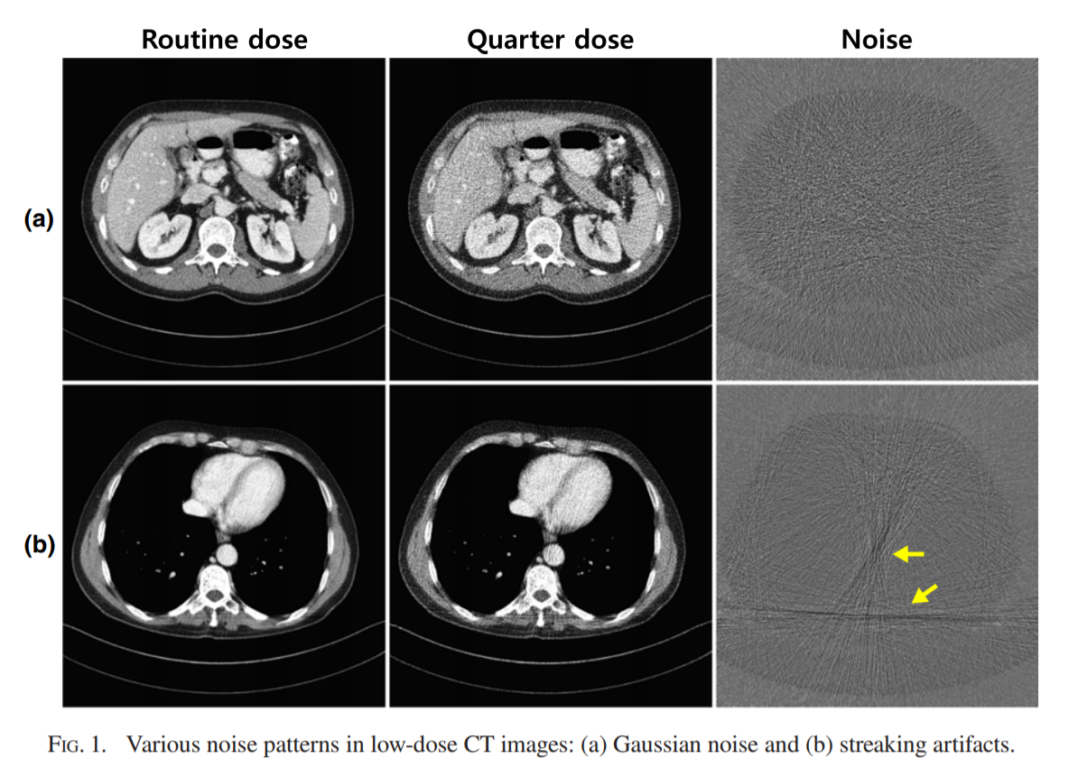
Low-dose CT reconstruction
Dataset was synthetically generated by adding poisson noise to the high-dose CT.
Task:
Convert a “low-dose” CT image
to a “high-dose” one.
Less dose
= less energy of X-rays entering
the body
= less ionizing radiation.
Kang et al., A deep CNN for Low-dose CT reconstruction, Medical Physics, 2017

Slide 22
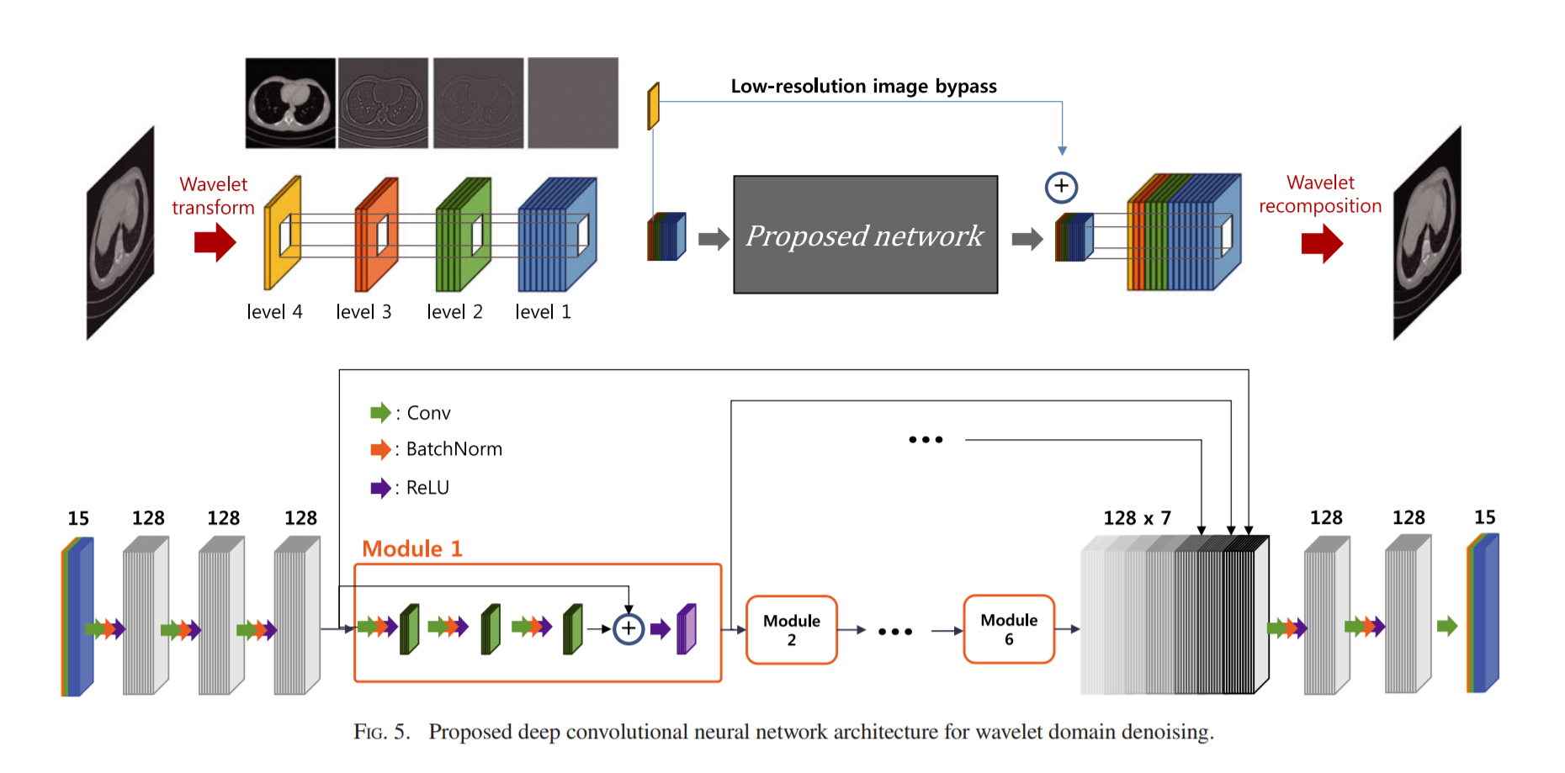
Low-dose CT reconstruction
Dataset was synthetically generated by adding poisson noise to the high-dose CT.
2k images were used for training.
Loss function: L-2 discrepancy
Kang et al., A deep CNN for Low-dose CT reconstruction, Medical Physics, 2017

Slide 23
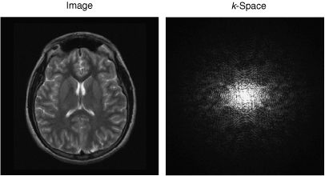
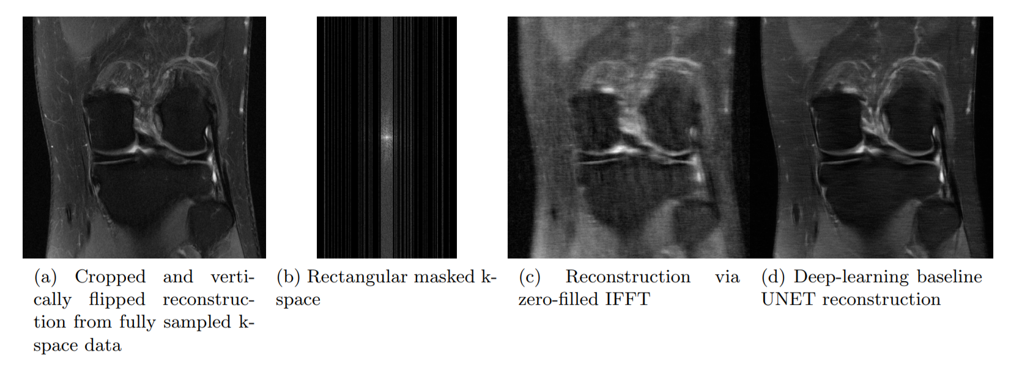
Fast MRI reconstruction
MRI data is acquired in k-space (Fourier domain).
Task:
Reconstruct high-resolution image from undersampled k-space data.
Undersampled k-space
= faster MRI acquisition.
Image: fastMRI, Facebook + NYU, November 2018

Slide 24
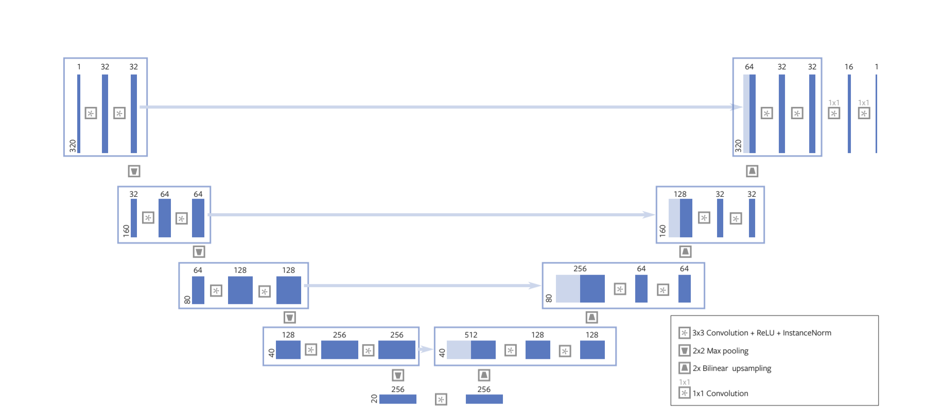
Fast MRI reconstruction
1594 volumes were used for training.
Loss function: L-1 discrepancy
Undersampled
MRI
Fully sampled
MRI
Image: fastMRI, Facebook + NYU, November 2018

Slide 25
Fast MRI Reconstruction
Image: fastMRI, Facebook + NYU, November 2018

Slide 26
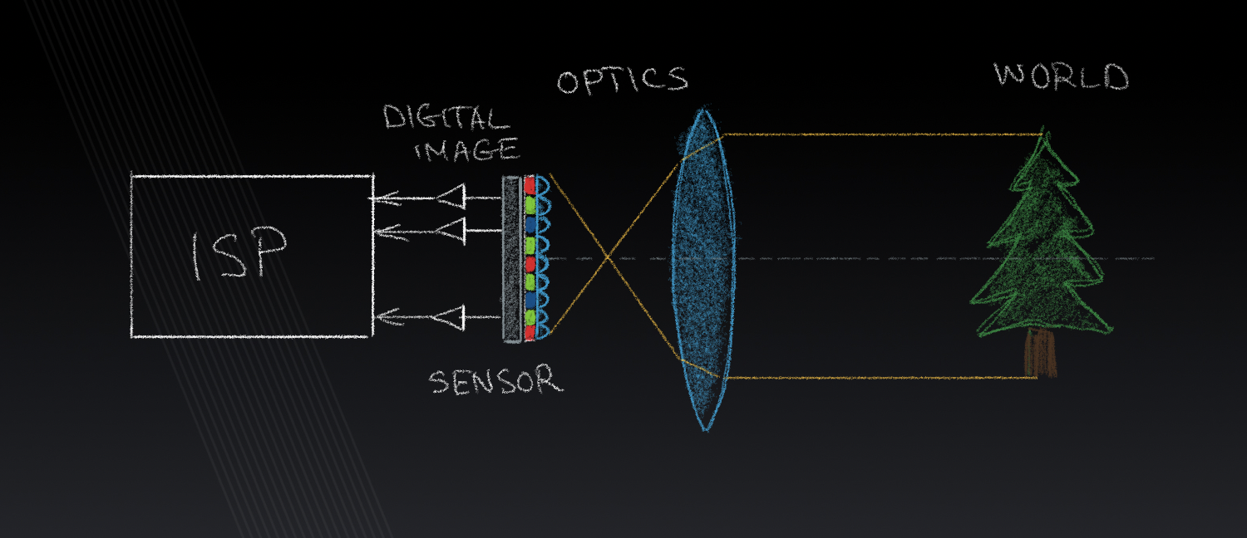
DeepISP: learned image-signal processing pipeline
Image: © Alex Bronstein, Lecture 11, DIP
Low-light images: the scene captured with a smaller exposure (less photons hit the sensor).
Well-lit images: the scene captured with a longer exposure (enough photons hit the sensor).
Schwartz et al., DeepISP, IEEE TIP, 2019

Slide 27
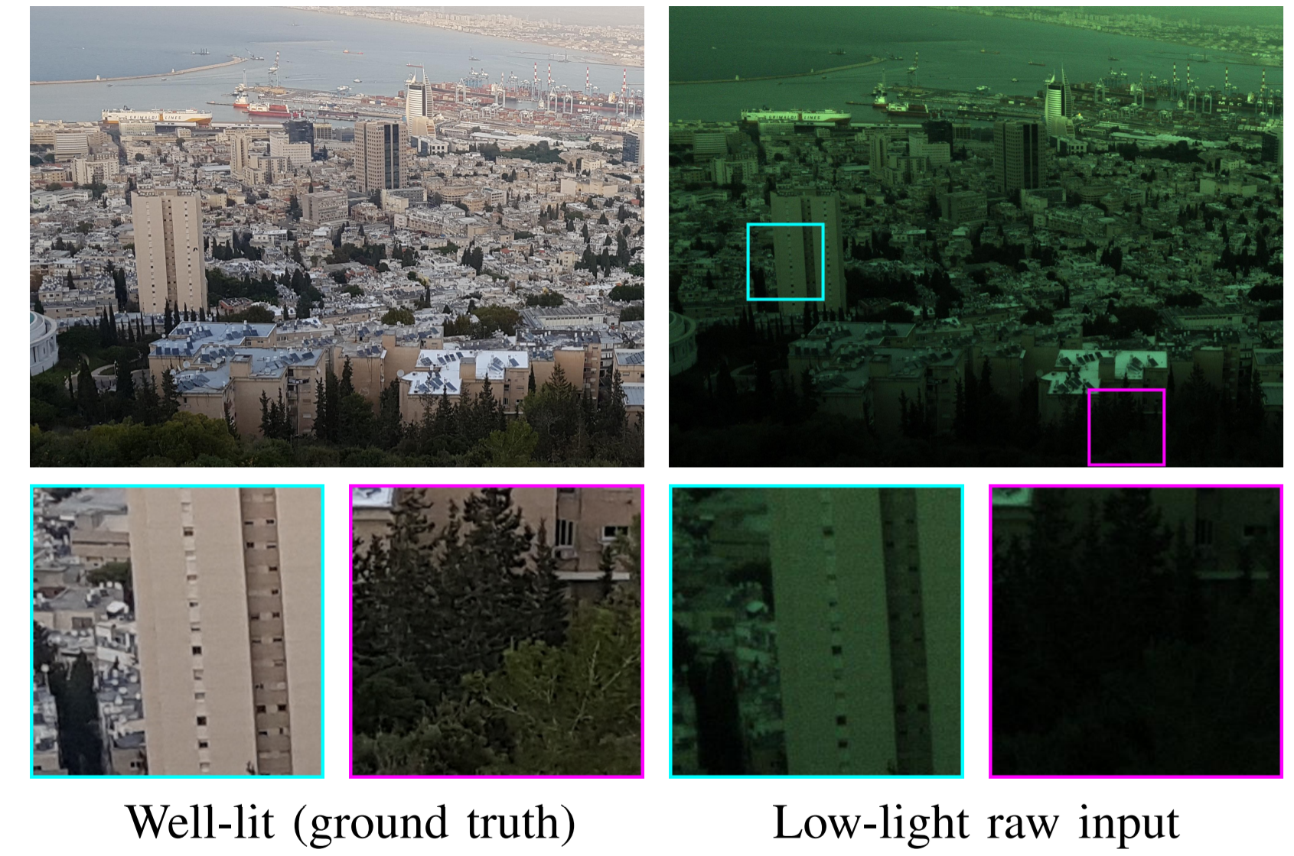
Dataset is collected
by acquiring both
low-light and well-lit
images by controlling
the exposure time of
the camera.
Schwartz et al., DeepISP, IEEE TIP, 2019

Slide 28
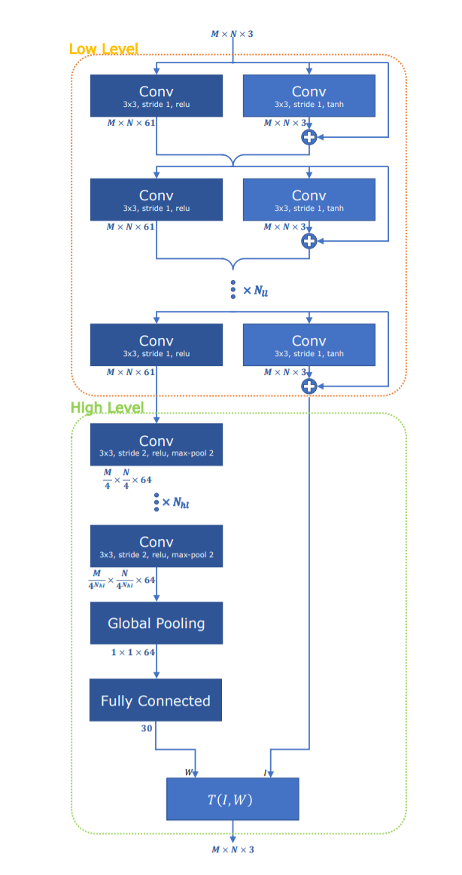
DeepISP
Traditional ISP:
Low level: denoising + demosaicing.
High-level: Gamma correction, color correction
DeepISP:
Low-level network: denoising + demosaicing
High-level network: color + Gamma correction
Loss: L1-error + Multi-scale SSIM
Schwartz et al., DeepISP, IEEE TIP, 2019

Slide 29
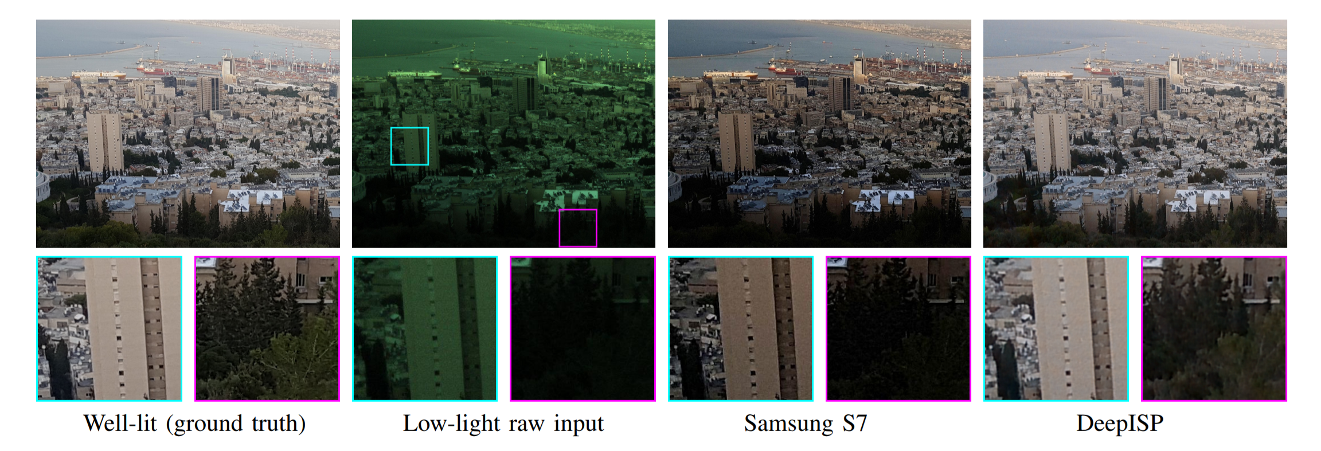
DeepISP: learned image-signal processing pipeline
Schwartz et al., DeepISP, IEEE TIP, 2019

Slide 30
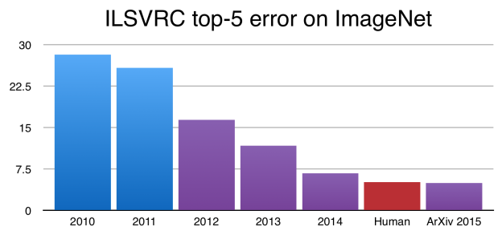
Meanwhile, in image classification
ImageNet has 1M images with 1000 categories.

Slide 31

AlexNet
Krizhevsky et al., AlexNet, 2012

Slide 32
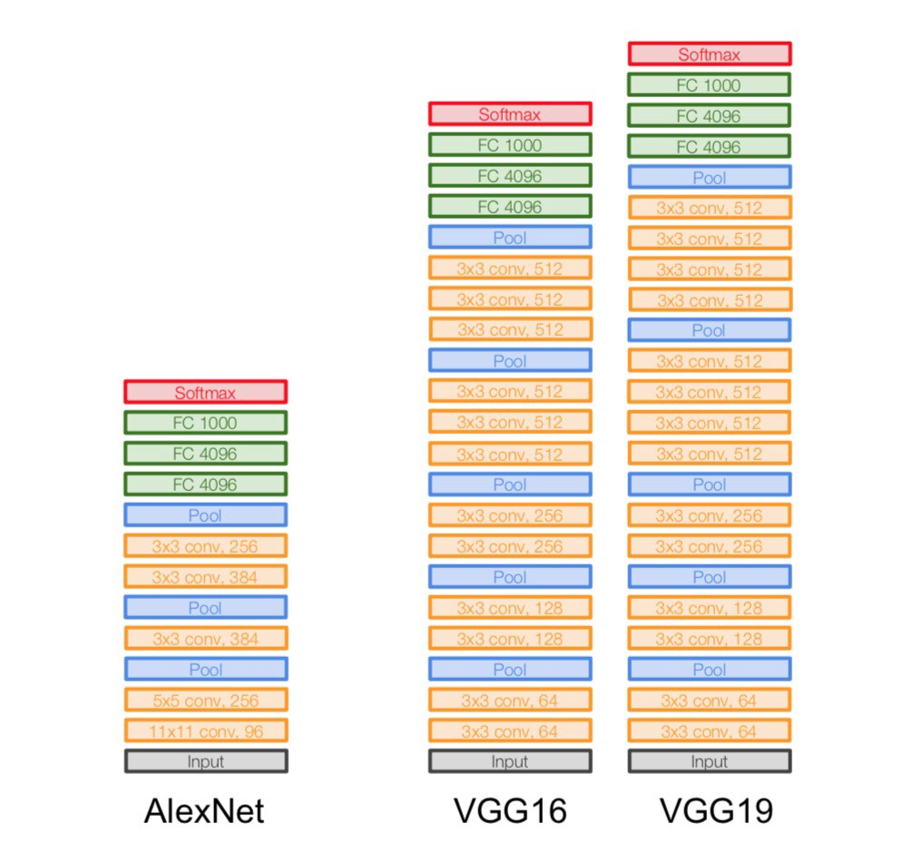
VGGNet
Image: VGG group, Oxford, 2014; © Zieler & Fergus, 2013.

Slide 33
Perceptual losses
Style reconstruction loss:
A measure to quantify for “style”: Gram matrix of the feature maps of a layer
Feature reconstruction loss:
Instead of optimizing pixel-wise loss, optimize the distance between “deep” features can preserve higher level details.
Johnson et al., ECCV 2016

Slide 34

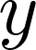
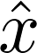
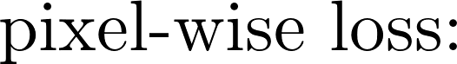
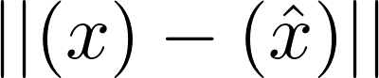

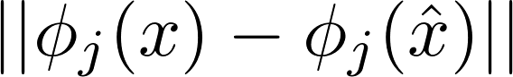
Feature reconstruction loss
Key idea: VGG features contain semantic information. Reconstructing images by optimizing for similar VGG features will lead to “perceptually” better looking images.
ground-truth:
CNN
Johnson et al., ECCV 2016

Slide 35
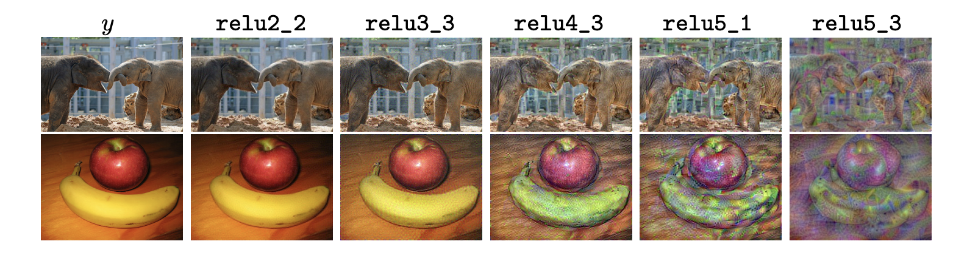
Feature reconstruction loss
Visualization of feature maps from VGG-16:
Johnson et al., ECCV 2016

Slide 36
Super-resolution
Input low
resolution image
Network output
Groundtruth high resolution image
CNN
Johnson et al., ECCV 2016

Slide 37
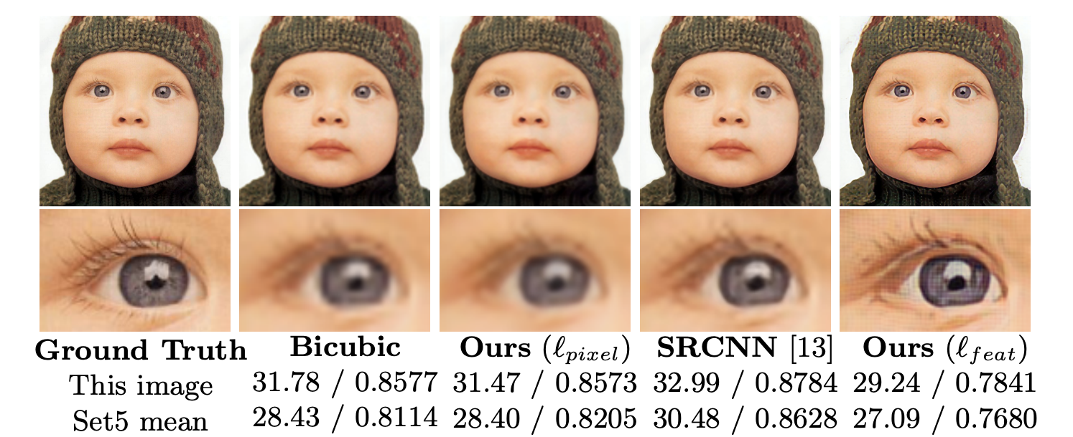
Super-resolution
Notice the PSNR and SSIM!
PSNR and SSIM are not good perceptual measures!
Johnson et al., ECCV 2016

Slide 38
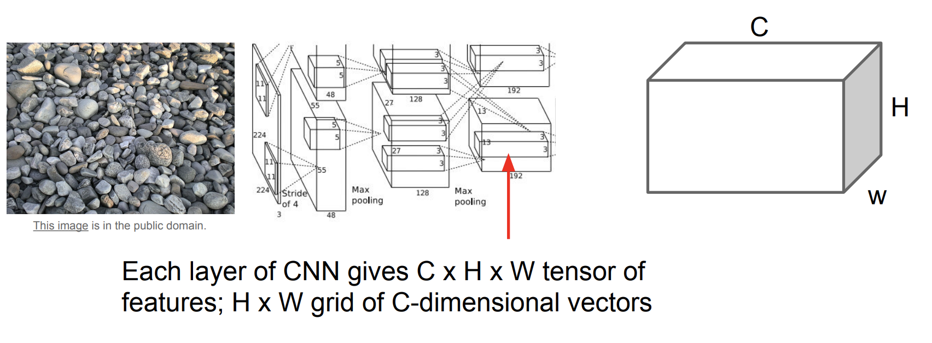
Style reconstruction loss
Johnson et al., ECCV 2016; © CS231n, Stanford

Slide 39
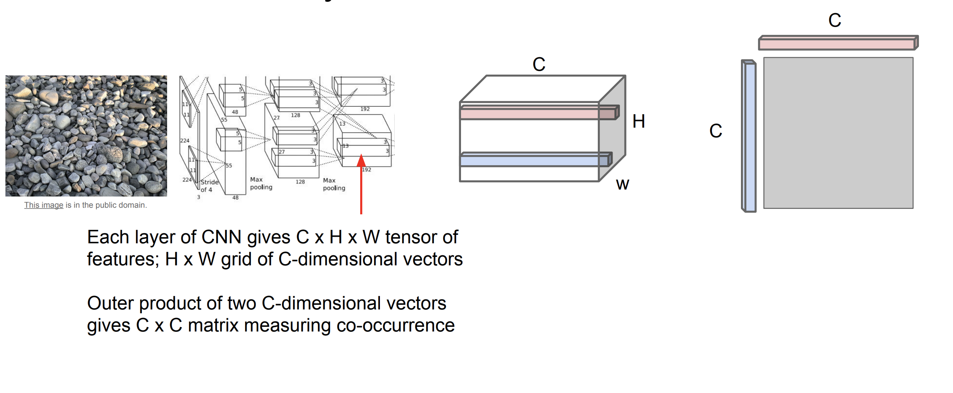
Style reconstruction loss
Johnson et al., ECCV 2016, © CS231n, Stanford

Slide 40
Style reconstruction loss
Johnson et al., ECCV 2016; © CS231n, Stanford

Slide 41
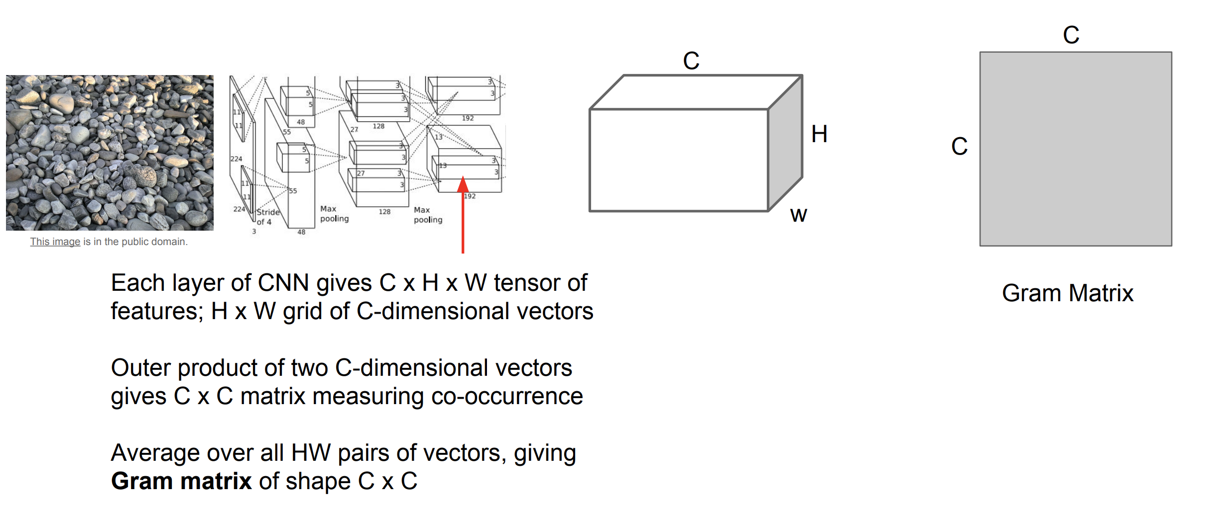

Style reconstruction loss
Notice that the style reconstruction loss doesn’t carry
any spatial information of the image.
Johnson et al., ECCV 2016, © CS231n, Stanford

Slide 42


Style reconstruction loss
Johnson et al., ECCV 2016, © CS231n, Stanford

Slide 43

Style reconstruction loss
Visualization of Gram matrices
Notice that the style reconstruction loss doesn’t carry
any spatial information of the image.
Johnson et al., ECCV 2016

Slide 44

Neural style transfer
© Johnson et al., ECCV 2016; CS231n, Stanford

Slide 45

Neural style transfer
© Johnson et al., ECCV 2016; CS231n, Stanford

Slide 46

Neural style transfer
© Johnson et al., ECCV 2016; CS231n, Stanford

Slide 47

Neural style transfer
Johnson et al., ECCV 2016

Slide 48
Neural style transfer
Johnson et al., ECCV 2016
Total-variation loss

Slide 49

Neural style transfer
Johnson et al., ECCV 2016

Slide 50

Neural style transfer

Slide 51
Thanks!

Slide 52

Neural style transfer
© Gatys et al., 2015; Johnson et al., ECCV 2016; CS231n, Stanford

Slide 53

Neural style transfer
© Gatys et al., 2015; Johnson et al., ECCV 2016, CS231n, Stanford

Slide 54

Neural style transfer
© Gatys et al., 2015; Johnson et al., ECCV 2016; CS231n, Stanford

Slide 55
Neural Style Transfer
© Gatys et al., 2015; Johnson et al., 2016; CS231n, Stanford

